Slide 1

Session Name:
Measures of Central Tendency
Delivered By:
Vikash Singh

Slide 2

Learning Objectives
By the end of this session, you will be able to:
Understand Mean, Median, and Mode
Solve for ungrouped and grouped data
Analyze properties and applications
Engage through solved examples and quizzes

Slide 3
What is Central Tendency?
Identifies a representative value
Summarizes large datasets
Called as 'averages'
600, 400, 650, 350

Slide 4
Functions of a Central Measure (an Average)
Represents entire data
Facilitates comparison
Simplifies complex data
Aids decision-making

Slide 5
Characteristics of a Good Measure
Rigidly defined
Easy to compute
Based on all observations
Not unduly affected by outliers (ideally)

Slide 6
Various Measures of Central Tendency
Measures of Central Tendency
Mean
Median
Mode

Slide 7
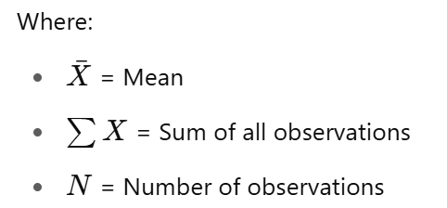
Mean
Formula:
Mean (X̄) = ΣX / N
Sum of deviations from mean = 0
Affected by extreme values

Slide 8
Mean
Example:
Marks: 50, 60, 70, 80, 90
X̄ = ?
Ex. Marketers often calculate the mean revenue earned per advertisement so they can understand how much money their company is making on each ad.
Revenue-> TV Newspaper Radio Online
Adv 1 5 4 3 6
Adv 2 1 2 2 2
Adv 3 2 5 1 64

Slide 9
Merits and Demerits of Mean
Merits:
- Easy to calculate
- Uses all data points
Demerits:
- Affected by extreme values
- Not suitable for qualitative data

Slide 10
Median
Odd N: Middle value
Even N: Average of two middle values
Example (Odd):
Data: 10, 20, 30, 40, 50
Median = ?
Example (Even):
Data: 10, 20, 30, 40
Median = ?

Slide 11
Median
Odd N: Middle value
Even N: Average of two middle values
Example (Odd):
Data: 10, 20, 30, 40, 50
Median = 30
Example (Even):
Data: 10, 20, 30, 40
Median = (20+30)/2 = 25

Slide 12
Merits and Demerits of Median
Merits
Not affected by outliers
Represents middle value
Suitable for skewed data
Demerits
Ignores extreme values
Not suitable for further algebraic operations

Slide 13
Mode
Definition: Value occurring most frequently.
Example:
Data: 5, 8, 8, 10, 12, 8, 15
Mode = ?
Merits
Represents most common value
Not affected by outliers
Useful in categorical data
Demerits:
No unique mode sometimes
Irregular distribution issues

Slide 14
Relation Between Mean, Median, Mode
Empirical Formula:
Mode = 3(Median) - 2(Mean)
Q: If Mean = 60, Median = 55, find Mode? A) 35 B) 50 C) 65 D) 45

Slide 15
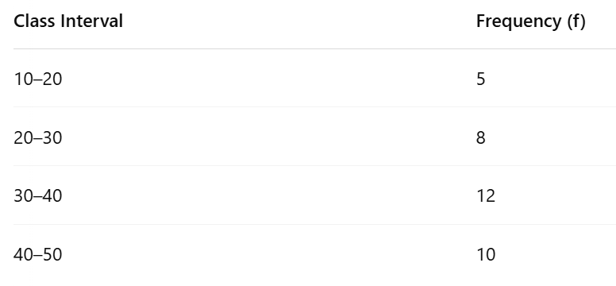
Mean for Grouped Data
Formula:
X̄ = Σ(f × X) / Σf
X = Midpoint = (Lower limit + Upper limit)/2

Slide 16
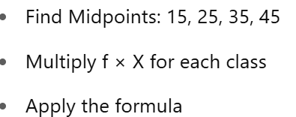
Mean for Grouped Data
Formula:
X̄ = Σ(f × X) / Σf
X = Midpoint = (Lower limit + Upper limit)/2

Slide 17
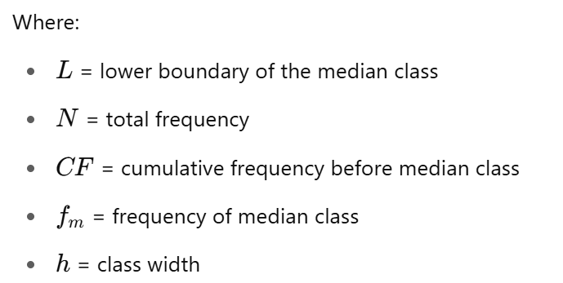
Median for Grouped Data
Formula:
Median = L + [(N/2 - CF)/f] × h

Slide 18
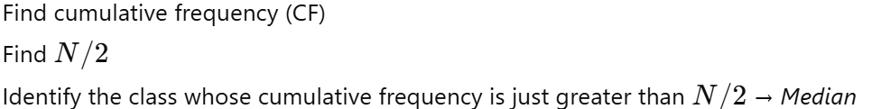
Median for Grouped Data
Formula:
Median = L + [(N/2 - CF)/f] × h
Class Interval | Frequency (f)
0–10 | 5
10–20 | 8
20–30 | 12
30–40 | 5

Slide 19
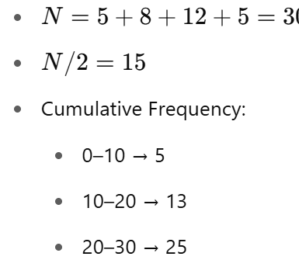

Median for Grouped Data
Formula:
Median = L + [(N/2 - CF)/f] × h
Class Interval | Frequency (f) CF
0–10 | 5 5
10–20 | 13
20–30 | 25
30–40 | 5 30

Slide 20

Median for Grouped Data
Formula:
Median = L + [(N/2 - CF)/f] × h
Median ≈ 21.67
Class Interval | Frequency (f) CF
0–10 | 5 5
10–20 | 13
20–30 | 25
30–40 | 5 30

Slide 21
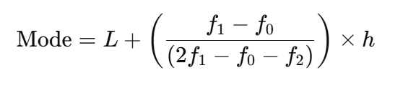
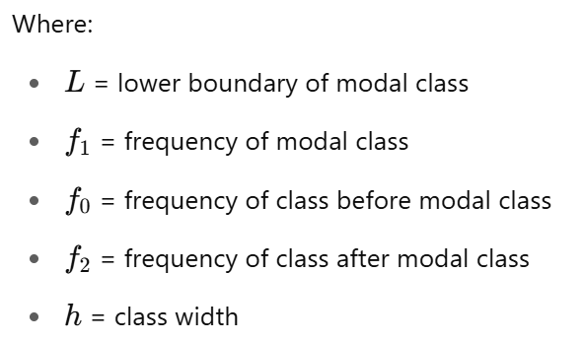
Mode for Grouped Data
Formula:

Slide 22
Mode for Grouped Data
Class Interval | Frequency (f)
0–10 | 4
10–20 | 6
20–30 | 10
30–40 | 8
Modal Class = ?

Slide 23

Mode for Grouped Data
Class Interval | Frequency (f)
0–10 | 4
10–20 | 6
20–30 | 10
30–40 | 8
Modal Class = 20–30 (highest frequency = 10)
Mode ≈ 26.67

Slide 24
MCQ
Q1: Sum of deviations from mean is?
A) 0
Q2: Which uses cumulative frequency?
A) Median
Q3: Mode in grouped data needs?
A) Highest frequency class

Slide 25
MCQ
Q1: Sum of deviations from mean is?
A) 0 ✅
Q2: Which uses cumulative frequency?
A) Median ✅
Q3: Mode in grouped data needs?
A) Highest frequency class ✅

Slide 26
MCQ
Q1: In a grouped table, the midpoint of 10–20 is: A) 10 B) 15 C) 20 D) 30
Q2: Which measure needs cumulative frequency table? A) Mean B) Median C) Mode D) Weighted mean
Q3: In the formula of mode, fo​ refers to: A) Modal class frequency B) Preceding class frequency C) Following class frequency D) Class width

Slide 27
MCQ
Q1: In a grouped table, the midpoint of 10–20 is: A) 10 B) 15 ✅ C) 20 D) 30
Q2: Which measure needs cumulative frequency table? A) Mean B) Median ✅ C) Mode D) Weighted mean
Q3: In the formula of mode, fo​ refers to: A) Modal class frequency B) Preceding class frequency ✅ C) Following class frequency D) Class width

Slide 28
Takeaways
Mean: All data, affected by outliers
Median: Middle value, robust to outliers
Mode: Most frequent, best for categorical
Choose appropriate measure based on data

Slide 29
Session Summary
In this session, we have discussed about:
Understand Mean, Median, and Mode
Solve for ungrouped and grouped data
Analyze properties and applications
Engage through solved examples and quizzes

Slide 30

Happy Learning

